Slide 1

ISOBERT
By Kai Mihata and Rishi Jha
Notes:
Quick overview of highlights

Slide 2
Problem
Large text embeddings (768 dimensional)
The smaller the features the better!
Does text have internal geometry.
How do we reduce dimensionality of DistilBERT?
Notes:
State of the art deep textual analysis models and small memory-constrained NLP projects alike could benefit from smaller sentence embeddings.
While there is a lot of work being done optimizing the models themselves, another approach is reducing the dimensionality of the output embeddings directly from existing transformers.
We hypothesize that for many problems, high dimensional features can be reduced to much smaller dimensionality using its underlying textual geometry to accomplish the same goal.

Slide 3
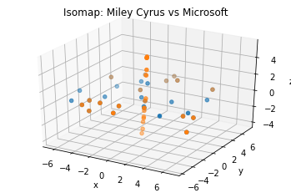
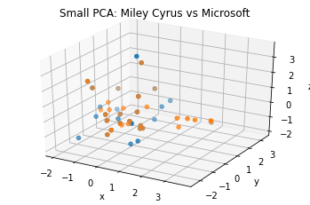
Motivation
Linear vs. Nonlinear Dimensionality reduction
Party in the USA vs. Microsoft Service Agreement
Notes:
Linear is faster
Nonlinear is focuses more on internal geometry
Text has some internal geometry
Linear method doesn’t seem to pick up on anything
Non-linear seems to show some of this

Slide 4
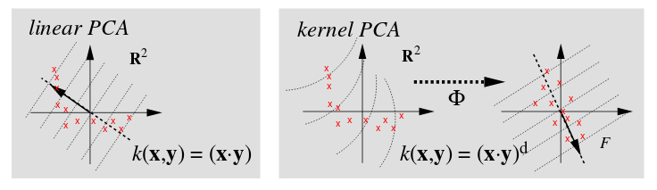
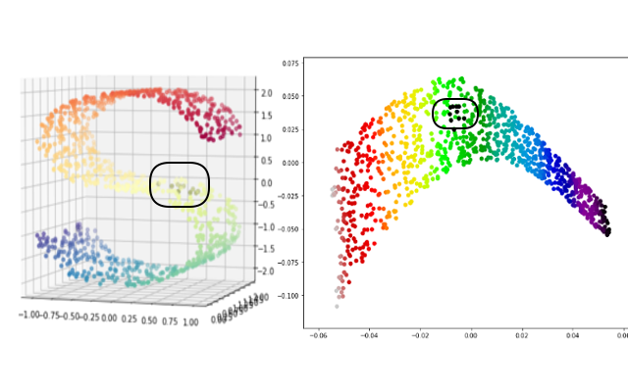
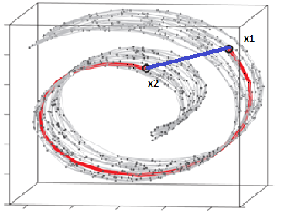
Nonlinear Reduction
Linear
PCA
~Kernel PCA
Isomap
~Kernel PCA
LLE and variants
link
LLE
Isomap
Notes:
Internal manifold
Kernel PCA has lots of similarities to linear method (PCA
T-SNE is too slow

Slide 5
Isomap Algorithm
Linear
PCA
~Kernel PCA
Determine the neighbors of each point
Construct a neighborhood graph
Compute shortest path between two nodes
Compute lower-dimensional embedding
link
Isomap
Notes:
Empirically we found Isomap works best
Algorithm here
We think that a lot of its advantage over LLE is comes from its prioritization global distance graph vs. LLE’s emphasis on locality

Slide 6
Methodology - Embeddings
IsoBERT
DistilBERT
Large
Isomap
PCA
Small
PCA
N x 768
N x 64
N x 16
Notes:
* Name the three embeddings

Slide 7
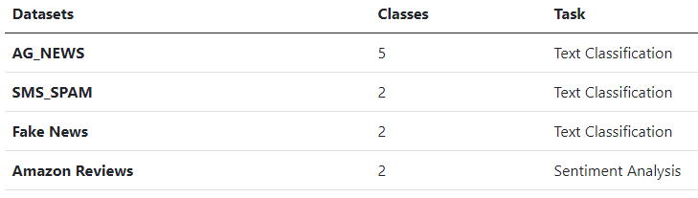
Methodology - Datasets
4 datasets
Text Classification
Sentiment Analysis

Slide 8
Experiments
Optimized Hyperparameters:
Large PCA: 64 components
Isomap: 16 components, 32 neighbors
Small PCA: 16 components
Model
Two fully-connected layers with hidden dimension 32

Slide 9
Results
Isomap vs Small PCA
Same number of components
Isomap averaged ~1.1% better test accuracy
Isomap vs Logistic Regression
48-fold reduction in dimensionality
Only averaged ~1.7% worse
Isomap either converged faster
Isomap reduction was slower

Slide 10
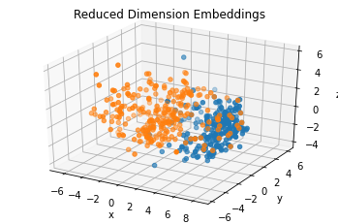
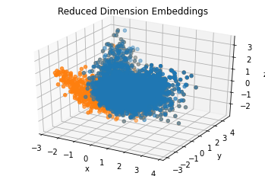
Selected Embedding Graphs
Isomap (SMS_SPAM)
Large PCA (AG_NEWS)

Slide 11
Future Work
Compare DistilBERT reductions to other embedding reductions
Test different Isomap flavors
Try a dimensionality reduction that is aware of model’s labels of the data

